Slide 1
Rates
October 2016

Slide 2
1) What is ALWAYS represented by the slope of the tangent to a graph of concentration vs. time for a reaction?
The activation energy for the reaction
The enthalpy change for the reaction
The initial rate of the reaction
The average rate of the reaction
The instantaneous rate of the reaction

Slide 3
2) What is required for a collision between reactant particles to be effective?
a)The enthalpy change must be negative
b) The collision geometry must be favourable
c) The collision must have sufficient energy
d) Both a) and b)
e) Both b) and c)

Slide 4
3) Why does increasing the temperature increase the reaction rate?
At higher temperatures, the activation energy is lower
At higher temperatures, there are more collisions per unit time
At higher temperatures, the particles have more kinetic energy
Both a) and c)
Both b) and c)

Slide 5
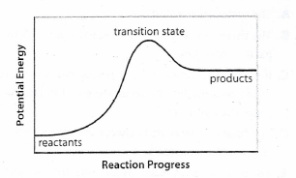
4) Which statement is false?
The reverse reaction is endothermic
E_{a} reverse is less than E_{a} forward
ΔH_{forward} is a positive quantity
ΔH_{reverse} is a negative quantity
ΔH_{reverse} is equal in magnitude to ΔH_{forward}

Slide 6
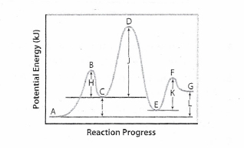
5) Which of the following statements is true?
D is a reaction intermediate
The overall reaction if endothermic
We cannot tell how many steps are in the reaction mechanism from the diagram
A→C is the fastest step
E is an activated complex

Slide 7
6) Which of the following is not a factor that controls the rate of the reaction
a. chemical nature of the reactants
b. concentration of the reactants
c. the number of products formed
surface area
temperature

Slide 8
7) The presence of a catalyst is thought to increase the rate of a reaction by
a. changing the products that are formed in the reaction
b. decreasing the enthalpy change of the reaction
c. increasing the enthalpy change of the reaction
d. decreasing the activation energy of the reaction
e. increasing the activation energy of the reaction

Slide 9
8) If for the reaction: aX + bY → product the rate law is Rate = k [X][Y]², the order of the reaction is:
1
2
3
4
5

Slide 10
9) If for the reaction: aX + bY → product the rate law is Rate = k [X][Y]⁰, then:
a) doubling the concentration of Y will double the rate of the reaction
b) halving the concentration of Y will double the rate of the reaction
c) doubling the concentration of X will double the rate of the reaction
d) halving the concentration of X will double the rate of the reaction
e) only changes to the concentration of Y will affect the rate of the reaction

Slide 11
10) Rates of reaction can be explained by
a. atomic theory
b. collision theory
c. kinetic molecular theory
rate theory
all of the above

Slide 12
11) Which of the following is not part of the collision theory?
a chemical system consists of particles that are in constant motion
b. a reaction must involve collisions of particles
c. an effective collision has sufficient energy and correct orientation
d. an ineffective collision can still cause a reaction
the rate of the reaction depends on the frequency of effective
collisions

Slide 13
12) Ineffective collisions are collisions that involve particles
a. without enough energy to react
b. with the wrong orientation
c. that rebound from the collision unchanged
d. that cannot react
e. all of the above

Slide 14
13) The amount of energy required for a reaction to begin is known as
a. enthalpy change
b. reaction energy
c. activation energy
kinetic energy
potential energy

Slide 15
14) The activated complex
a. is an unstable molecule
has the maximum potential energy possible
may continue on to produce products
d. may revert to reactants
e. all of the above

Slide 16
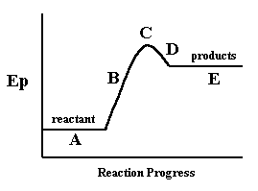
15) In the following diagram, the letter which represents the position of the activated complex is:
A
B
C
D
E

Slide 17
16) If a reaction can be broken down into a reaction mechanism, then the steps of the reaction mechanism are known as
a. stages of reaction
b. activated complexes
c. reaction progress
elementary steps
primary equations

Slide 18
17) The number of particles that would usually "collide" in an elementary step are
a. 1-2
b. 3-4
c. 5-6
Unlimited
no particles need to collide

Slide 19
18) Reaction mechanisms:
a. are easily determined
cannot be determined without knowing the enthalpy of the reaction
c. are only 'best guesses' at the behaviour of molecules
d. do not need to represent the whole reaction
e. do not involve any reaction intermediates

Slide 20
19) The rate-determining step is:
a. the first step in a reaction mechanism
b. the last step in a reaction mechanism
c. the slowest step in a reaction mechanism
d. the fastest step in a reaction mechanism
e. the only step in a reaction mechanism

Slide 21
20) Reaction intermediates are:
a. steps within a reaction mechanism
b. the step that determines the rate of the reaction
c. products formed in the overall equation
d. products formed within some steps of the reaction mechanism
e. none of the above

Slide 22
21) The theoretical effect of an increase in temperature can be explained in terms of collision theory because it affects I. the collision geometry involved in the reaction II. the total number of collisions that occur III. the fraction of collisions that are effective IV. the required activation energy for a reaction
a. both I and IV
b. I, II and III are true
c. both II and III
both III and IV
II only

Slide 23
22) The theoretical effect of an increase in the initial concentration of a reactant can be explained in terms of collision theory because it affects I. the collision geometry involved in the reaction II. the total number of collisions that occur III. the fraction of collisions that are effective IV. the required activation energy for a reaction
a. both I and IV
b. I, II and III are true
c. both II and III
both III and IV
II only

Slide 24
23) The theoretical effect of a catalyst can be explained in terms of collision theory because it affects I. the collision geometry involved in the reaction II. the total number of collisions that occur III. the fraction of collisions that are effective IV. the required activation energy for a reaction
a. both I and IV
b. I, II and III are true c. both II and III
both III and IV
II only

Slide 25
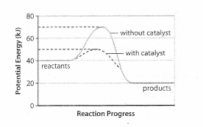
24) Which statement regarding the potential energy diagram below is false?
The E_{a} for the uncatalyzed reaction in the forward direction is +30 kJ
ΔH for the uncatalyzed reverse reaction is +30 kJ
The potential energy of the activated complex for the catalyzed reaction is +50 kJ
The catalyst lowers the activation energy of the forward and reverse reactions by 20 kJ
ΔH for the uncatalyzed forward reaction is +10 kJ

